Slide 1

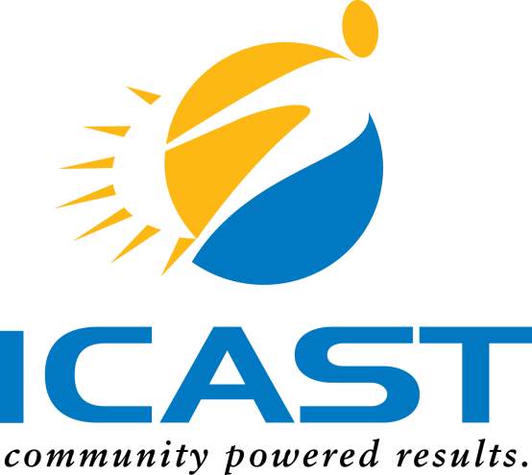
Marketing Rural Business Incubators:
Rocky Ford & Ordway, CO

Slide 2

What is Business Incubation?
A business support process that accelerates the successful development of start-up and fledgling companies by providing entrepreneurs with an array of targeted resources and services.
These services are usually developed or orchestrated by incubator management and offered both in the business incubator and through its network of contacts.
A business incubator’s main goal is to produce successful firms that will leave the program financially viable and freestanding.

Slide 3
Rural Business Incubators
Goals of marketing:
Establish and maintain program’s reputation within the community
Expand local, regional and state networks
With sponsors and partners, directly engage the community to create market analysis
Find candidates open to being a part of the incubator’s board of advisors
Attract new clients

Slide 4
Rural Vs. Urban Entrepreneurship
Four factors of a successful entrepreneurial venture:
Talent: creative individuals with an idea
Opportunity: ability to follow through with idea
Capital: ability to finance the venture
Know-how: ability to access networks and gain experience
Rural incubators lack access and community:
Fewer markets
Smaller industry clusters imperative for networking, capital and business development
Far distance from urban center discourages investment
Lack of entrepreneurial culture, mentors and willingness to take risks

Slide 5
Rural Incubator Challenges
Challenges associated with rural incubators can be overcome via:
Technological education and upgrades
Increased financial support from government and NGO’s
Enhanced community education and engagement
Rural incubators must market to:
Potential clients
Local community
Potential sponsoring businesses and partners

Slide 6
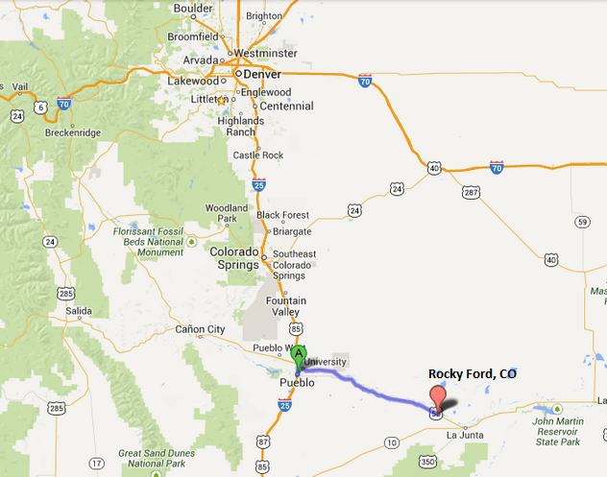
Rocky Ford, Colorado
Rocky Ford, CO is 1 hour South-East of Pueblo, CO and is the first rural community that is focused upon for incubation development.

Slide 7
Rocky Ford Demographic Profile
Population: | 5,703
Population change since 2000 | -8%
Population with High School Diploma/ GED | 74.7%
Population with College Degree | 13.4%
Population Native Born | 93.1%

Slide 8
Rocky Ford Economic Profile
Household Median Income: | $26,597
Occupations:
Sales & Administrative | 23.4%
Services | 22.7%
Agriculture, Construction & Maintenance | 11.8%

Slide 9
Rocky Ford Incubator
Strengths | Weaknesses
Incubator centrally located Close-knit community Wide variety of businesses Close proximity to higher educational facilities | Lack of consistent clients Weak business website Lack of strong management with direction for business Lack of financial and economic sponsors and advisors

Slide 10
Rocky Ford Incubation Outlook:
Opportunities | Threats
Many local organizations to create partnerships with Wide variety of local businesses with industry contacts and pertinent information | Declining population Unavailability of financial partners Lack of understanding and promotion of entrepreneurship within the community

Slide 11
Rocky Ford Incubator Plan of Action
Recommendations for Rocky Ford’s Business and Arts Incubator:
Revitalize reputation, become symbol within community
Find strong community leader
Join the Economic Development Council of Colorado
Join the Rocky Mountain Incubation Collaborative
Hold seminars with newly acquired expertise and feature speakers discussing issues pertinent to the community
Reach out to local businesses in need; NETWORK
Have clear and concise goals that resonate desire to benefit the community economically and socially

Slide 12
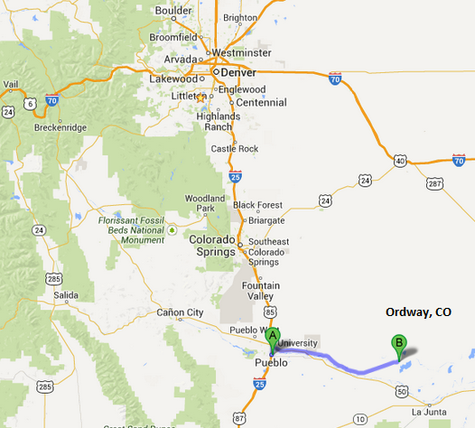
Ordway, Colorado
Ordway is located 1 hour South-East of Pueblo, CO . The community is smaller, less industrialized and declining in population more rapidly than Rocky Ford.

Slide 13
Ordway Demographic & Economic Profile
Population : | 1,080
Population change since 2000 | -12.6%
Population with High School Diploma/ GED | 74.7%
Population with College Degree | 11.4%
Median Household Income : | $29,352
Unemployment Rate | 5.6%

Slide 14
Ordway Incubator
Strengths | Weakness
*Colorado small business development center located in town * Connections within the community | *Non-operational

Slide 15
Ordway Incubation Outlook
Opportunities | Threats
* “Local” incubators to partner with Governor Hickenlooper’s “Bottom-Up” Economic Development Plan Variety of local businesses to network and partner with Existing local businesses to provide access to industry contacts, info. | Loss of credibility Decline in population Local incubators becoming competitors instead of partners

Slide 16
Ordway Incubator Plan of Action
Ordway Incubation Center must establish itself within the local and regional community:
Find a competitive advantage so that other regional incubation centers offer partnership
Acquire funding to develop new high tech office space so that new clients are attracted to the center

Slide 17

Thanks
QUESTIONS?
Michele Fisher
michelef@icastusa.org
1-866-590-4377
www.resourcesmart.org

